Slide 1
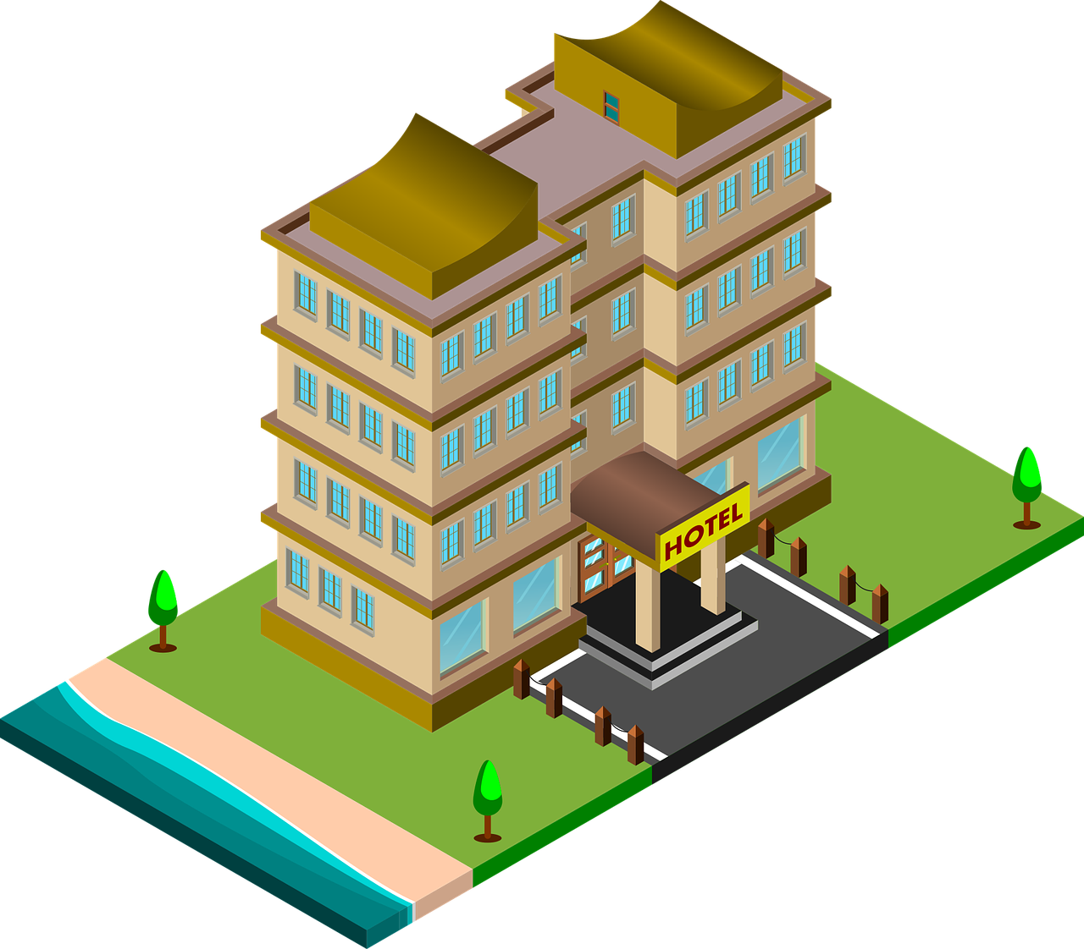
Balthazar's Inn.
LA2 Genius Joshua Balthazar

Slide 2
Balthazar's Inn.
LA2 Genius Joshua Balthazar

Slide 3
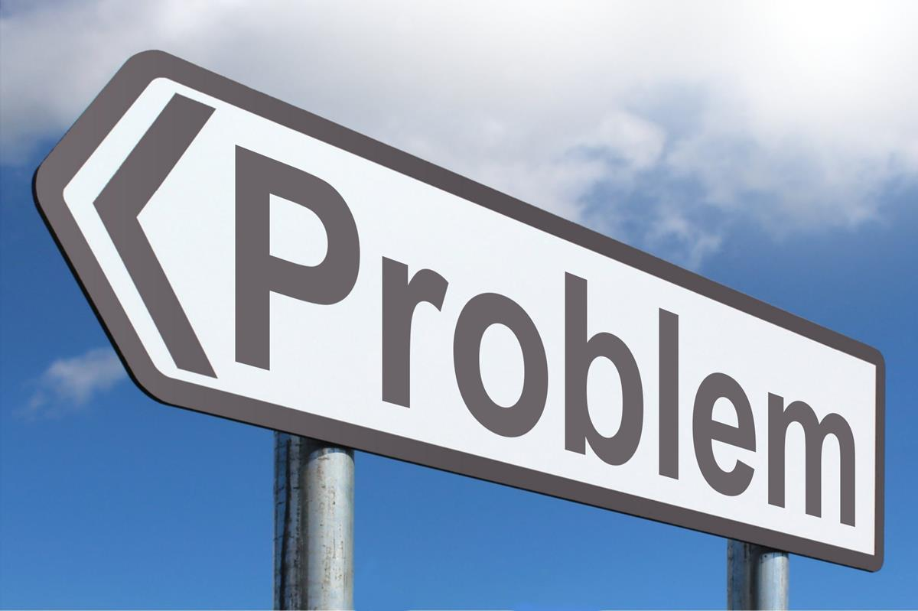
Problem
Service that allow customers to get affordable deals in local Inn’s and Housing Market
Price Matching analytical data for My Housing prices and third party users.

Slide 4

Solution
Good reviews
Affordable pricing
User Friendly Market Data
Balthazar’s housing Pricing

Slide 5

Traction/Market Size
Total addressable market:$177.6b Hotels & Housing in the US Market Size
Service available market: $59.6b is the market size of just north america
Service obtainable market: Balthazar’s housing and Inn will hold 4% of the hotels and housing market by 2027 which is 2.38b

Slide 6

Business Model
My business (Ordaeya) will have a
lot of investors who I will be reaching out to gain partnerships.
Also I will be surveying my local communities to look for analytical data to understand my targeted customers.
Notes:
2nd paragraph: My target customers will be people looking for cheaply priced Hotels and Houses, and also what type of activities there really into.

Slide 7
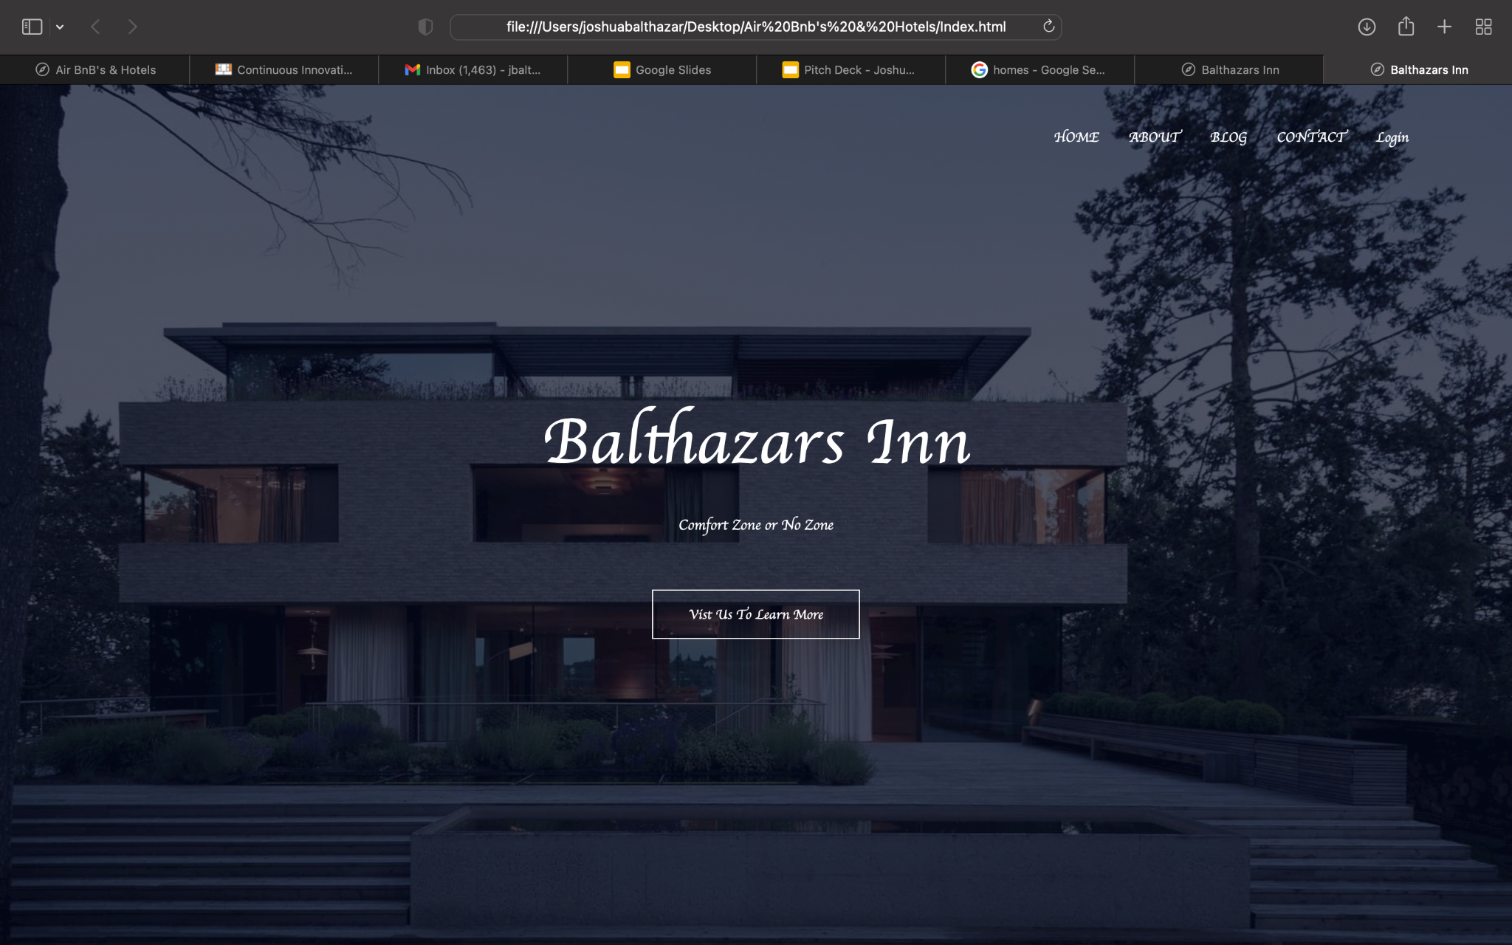
Proprietary​​ Technology/Expertise
Notes:
This is my main website, and these is one a the non-copyrighted images on the website, and there also a lot of info about the hotel’s and housing by the way….

Slide 8
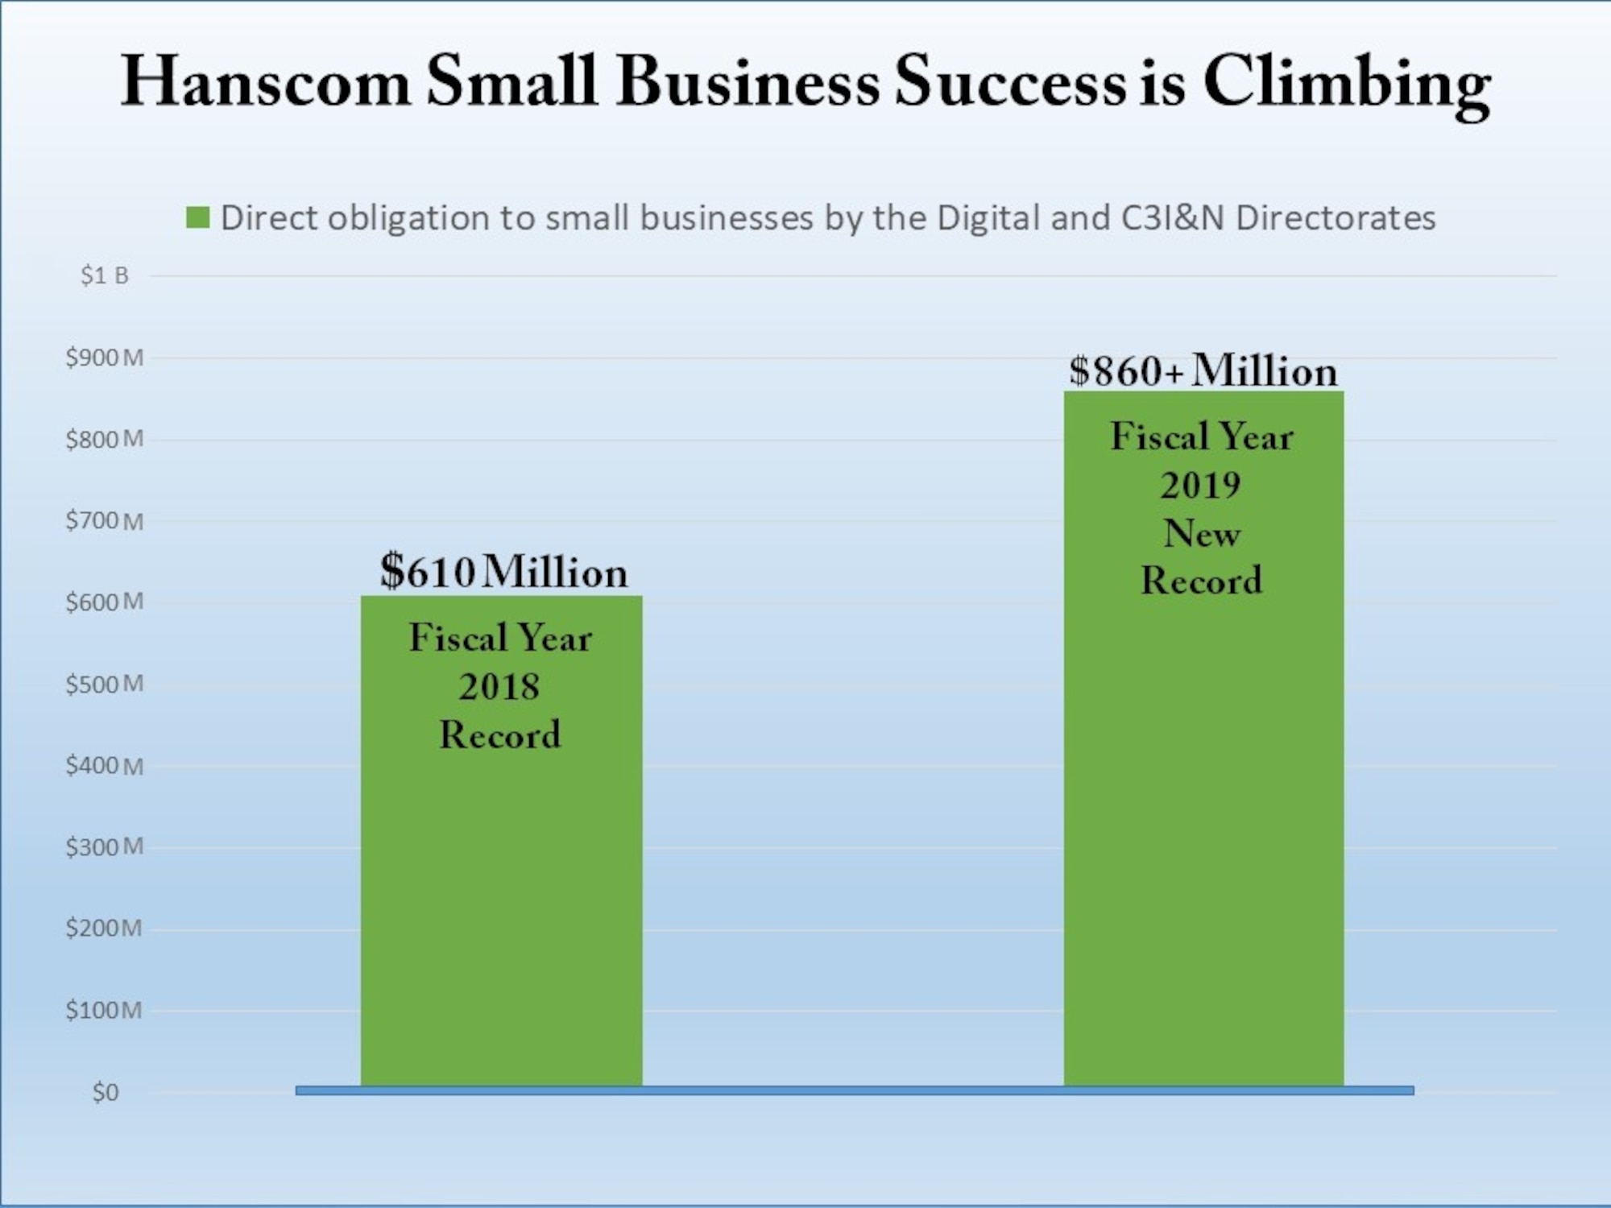
Competition
Other Hotel companies: My company will have the most widest hotel resort in the whole world compared to other companies. And you will have a lot to do there, and have fun activities as we’ll like, Basketball courts, A bunch of pools and a whirly pool, a food courts, and other things in the future
Other Airbnb: My Houses will come with costume snacks, paintings of the whole city, and will support with comfy beds and will have two of everything like, toilets, beds, and living rooms as we’ll.

Slide 9

Why US?
Our Mission for you to come to our business is because we have the most selections of Housing that you can select online, and with the hotel’s, you can have fun with your family and have some to do like relax and have indoor activities as well for you to do.
And There’s gonna be a lot of homemade food options for Breakfast and dinner as we’ll. And will have your personal washer and dryer for your rooms, just like your house my have, coming with supplies that we will have for you for complementary.

Slide 10

Go To Market Plan
My main idea for my market plan is to expand and have different surveys as well as some business partners who will invest as well. And have a schedule and list of things that need to be added in my list.

Slide 11
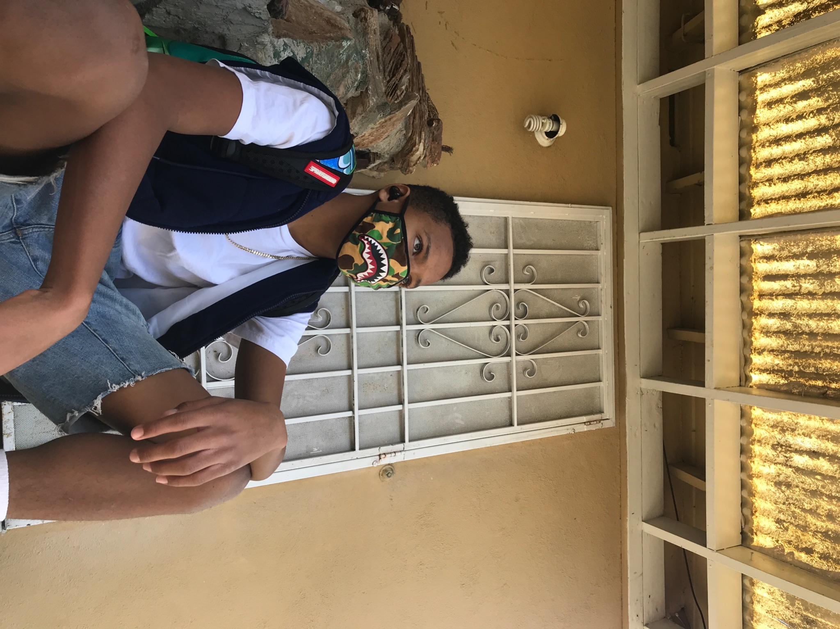

Founding Teams

Slide 12
Fundraising and Milestones
ASK $55,000 To help me start my Real Estate business

Slide 13
Problem
Service that allow customers to get affordable deals in Goodyear Air B&B’s
Price Matching analytical data for Airbnb prices and third party users.

Slide 14
Solution
Good reviews
Affordable pricing
User Friendly Market Data
Goodyear Pricing

Slide 15
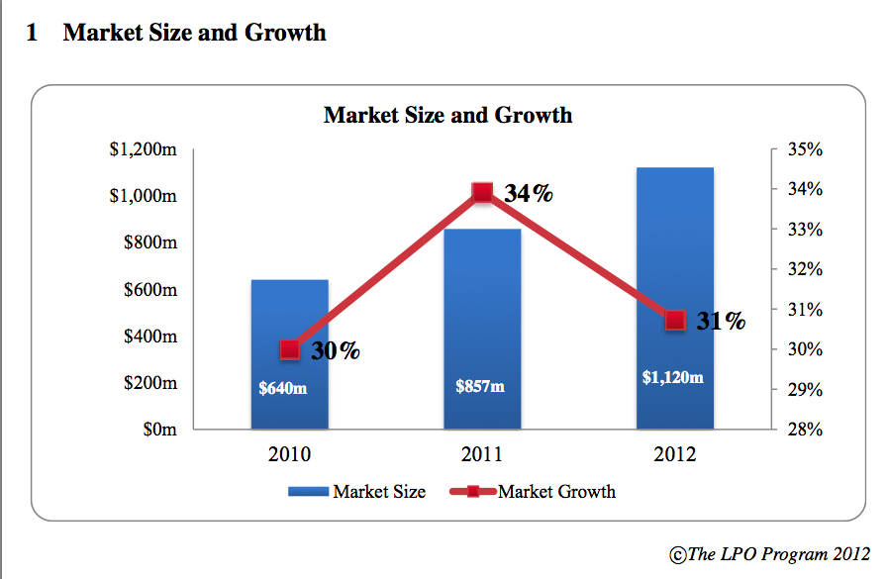
Traction/Market Size
Tam:$177.6b Hotels & Motels in the US Market Size
Sam: $59.6b is the market size of just north america
Som: J’s-Air B&Bs and hotels will hold 4% of the hotels and motels market by 2027 which is 2.38b

Slide 16
Business Model
My business (Ordaeya) will have a
lot of food options, and plus fast
food place inside the lobby other
than Hilton and I want people who mean business,
and want to have a quiet place to
work at.
And to pay for the Air BnB, you’ll would either book the Air BnB online, and same with Hotel, But you could book in person as we’ll.

Slide 17
Proprietary​​ Technology/Expertise

Slide 18
Competition
Other Hotel companies: My company will have the most widest hotel resort in the whole world compared to other companies in. And it will have a lot to do there and fun activities as we’ll like, Basketball courts, A bunch of pools and a whirly pool, a food courts, and other things in the future
Other Airbnb: My AirBnB will come with costume snacks, paintings of the whole city, and will support with comfy beds and will have two of everything like, toilets, beds, and living rooms as we’ll.

Slide 19
Why US?
Our purpose for you to come to my business is because we have the most selections of Airbnb’s that you can select online, and with the hotel’s, you can have fun with your family and have some to do like relax and have indoor activities as well for you to do.

Slide 20
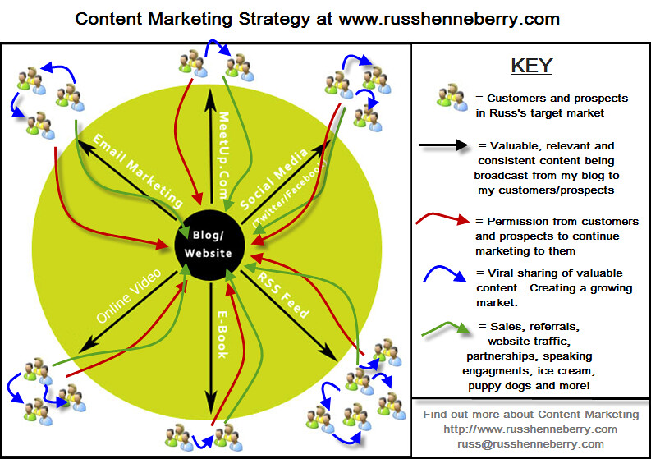
Go To Market Plan
My main idea for my market plan is to expand and have different survey’s as well as some business partners who will invest as well. And have a schedule and list of things that need to be added in my list.

Slide 21
Fundraising and Milestones
ASK $55,000 To help me start my Real Estate business

